Slide 1
Vigilance Awareness Week for the year 2025
"Vigilance: Our Shared Responsibility".

Slide 2
"Vigilance: Our Shared Responsibility".
The Vigilance Awareness Week (VAW) 2025, organized by the Central Vigilance Commission (CVC), will be observed from October 27 to November 2, 2025, with the theme "Vigilance: Our Shared Responsibility". The associated campaign runs from August 18 to November 17, 2025. A central feature of the public awareness initiative is the online e-pledge, encouraging citizens to commit to honesty and integrity in all aspects of life.

Slide 3
"Vigilance: Our Shared Responsibility".
Key aspects of Vigilance Awareness Week 2025
Theme: The theme "Vigilance: Our Shared Responsibility" highlights that fighting corruption requires the collective efforts of everyone, including the government, citizens, and the private sector.
Preventive vigilance campaign: Before VAW 2025, the CVC has instructed ministries and organizations to conduct a three-month campaign focusing on areas like disposing of pending cases and complaints, capacity building, asset management, and digital initiatives.
Outreach activities for the public: Activities such as "Awareness Gram Sabhas" in rural areas, grievance redressal camps by customer-focused organizations, visibility campaigns like walkathons, and the use of digital and social media are planned to engage citizens.

Slide 4
"Vigilance: Our Shared Responsibility".
The e-pledge initiative
The e-pledge is an online "Integrity Pledge" that encourages citizens to commit to ethical conduct.
The Integrity Pledge for citizens
By taking the Integrity Pledge, citizens commit to:
Following the rule of law in all aspects of life.
Neither giving nor accepting bribes.
Performing all tasks in an honest and transparent manner.
Acting in the public interest.
Leading by example and exhibiting integrity in personal behavior.
Reporting any incident of corruption to the appropriate authorities.

Slide 5
"Vigilance: Our Shared Responsibility".
How the public can participate
Citizens can take the e-pledge on the official CVC website or the MyGov pledge platform. The pledge for citizens includes commitments to follow the law, reject bribes, act honestly and transparently in the public interest, lead by example, and report corruption.
How to spread awareness
Citizens can promote the CVC's anti-corruption message and encourage participation in the e-pledge by using social media with the handles @CVCIndia and CVCofindia, website: https://pledge.cvc.nic.in/ encouraging others to take the pledge, and volunteering in community programs.
Please refer CVC website for details - https://cvc.gov.in/vaw.html

Slide 6
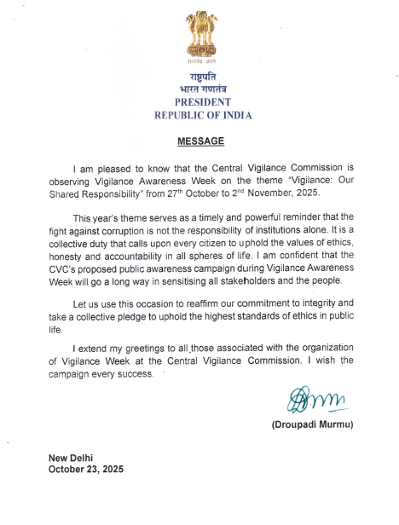
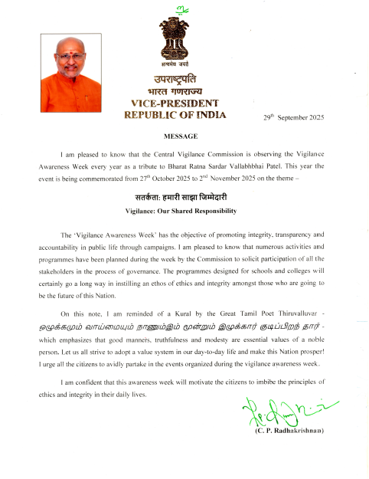

Slide 7
